Slide 1
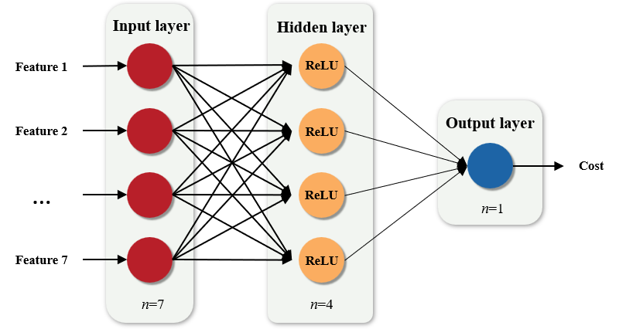
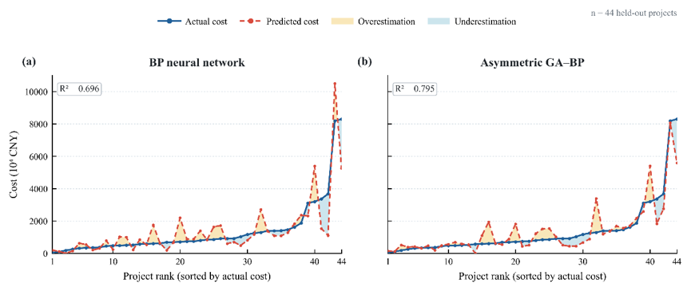
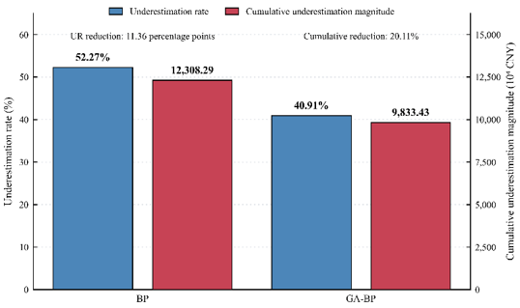
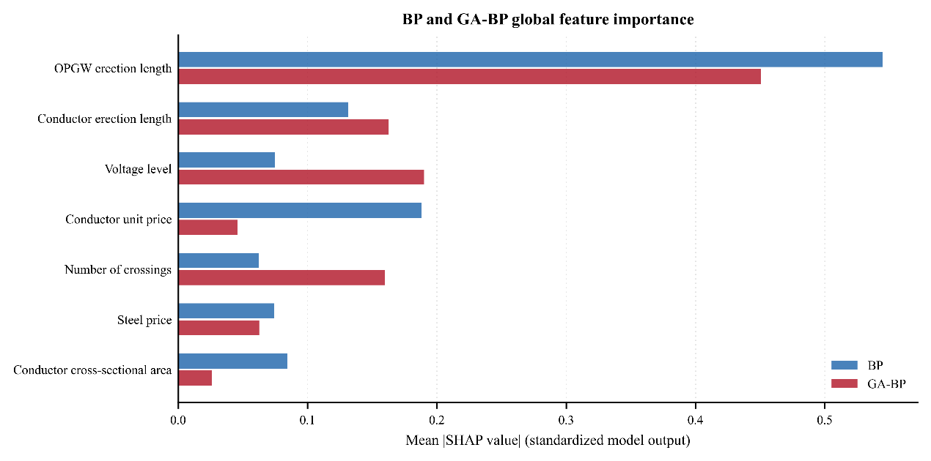


Indicator construction
Model design and training
Model evaluation
44 completed OHL projects
BP model
Prediction accuracy
Initial dataset
20 candidate features
+ Cost
Expert evaluation
Expert review
20 → 16 features
44-fold LOOCV
43 training projects
Underestimation risk
Sampling adequacy test
Factor analysis
Dataset
1 test project
16 → 14 features
Availability assessment
GA-BP model
Early-stage availability
$$T=τ⋅\max\left(E,0\right)+\left(1−τ\right)\max\left(−E,0\right)$$
SHAP
Fitness
function
$$f=\frac{1}{1+T}$$
14 → 7 early-stage inputs

Slide 2
Input layer
Hidden layer
Feature 1
ReLU
Feature 2
ReLU
Output layer
Cost
…
ReLU
n=1
Feature 7
ReLU
n=7
n=4

Slide 3




BP component
GA search
Network definition
Encode weights and biases as chromosomes
$$T=τ⋅\max\left(E,0\right)+\left(1−τ\right)\max\left(−E,0\right)$$
Specify 7-4-1 network topology
Initialize population n=80
$$f=\frac{1}{1+T}$$
Decode chromosomes
BP training after GA initialization
Forward prediction on training fold
Tournament selection k=3
Best-found initial weights and biases
Asymmetric pinball loss
Two-point crossover $P_{c}=0.80$
BP fine-tuning Adam · squared error
Gaussian mutation $P_{m}=0.15$
No
Yes
150 generation reached?
Held-out project cost prediction
Update population ; increment counter

